Slide 2
University of Sunderland Library Services for Distance Learners
Recommended reading on My Module Resources
Access to ebooks, online journal articles & more…
Document Delivery (for items not available online)
Online guides & videos
Help & support from Library Staff

Slide 3
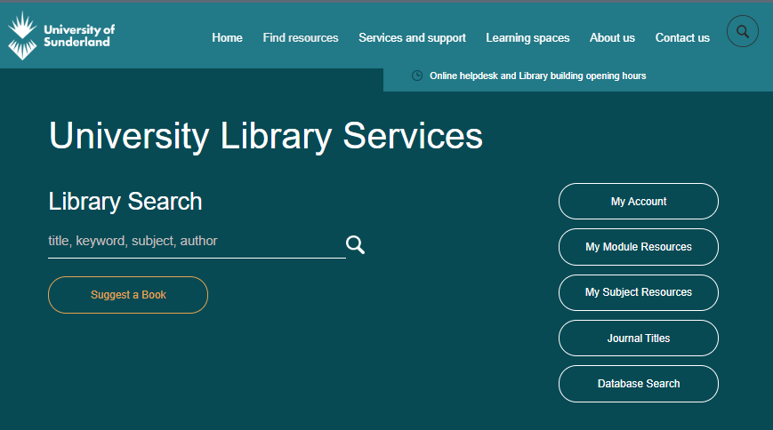
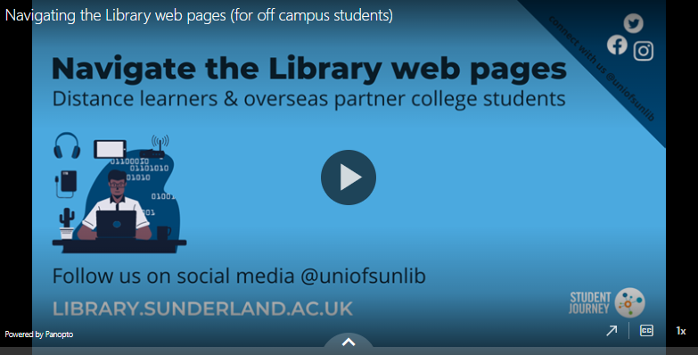
Begin at the University Library Web Page
Watch our video demo of the main parts of the web page (2:56 mins)
https://library.Sunderland.ac.uk
Notes:
Access to library resources – whatever you are looking for is from the library home page. You can choose to search for ebooks and journal articles from the Library Search box on the library web page.
Highlight the following:
Library Search box
Link to My Module Resources
There is a short video which helps you to navigate the library web page.

Slide 4
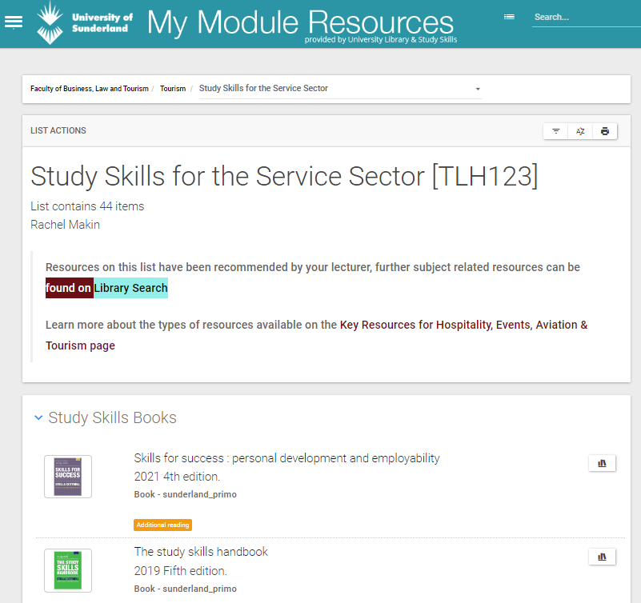
My Module Resources (Reading Lists)
Access via the Library Web Page
https://library.sunderland.ac.uk/
Reading recommended by your lecturers
Filter material
Direct links to e-resources
Notes:
My module Resources is the University of Sunderland online reading list. There is a list for every module that is taught which is made up of titles recommended by module leaders at Sunderland. Where ebooks are available there will be direct links to them and there will also be links to any recommended journals or journal articles too.

Slide 5
Wider Reading (ebooks)
Read online or Download
Choose Read Online for interactive features such as adding notes & searching full text.
Watch the ebooks video (4:07 mins)
Learn more about ebooks
Notes:
Many of the books in our collection are available as ebooks. Some may be on your reading list but you can find other ebooks on Library Search – start your search on the library web page. Watch the short ebooks video for a demonstration.
The link to learn more about ebooks answers the most common questions about ebooks including the difference between read online and download, ebook availability, printing from ebooks and more.

Slide 6
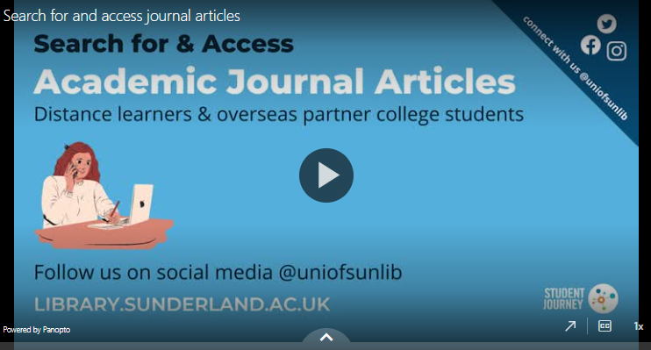
Wider Reading (journals)
Full text access to millions of journal articles
Pin useful articles & searches on Library Search
Watch the journals video (4:26 mins)
Notes:
University of Sunderland Library subscribe to lots of academic journals. You can find them all via the library web pages – you can search by keyword.

Slide 7
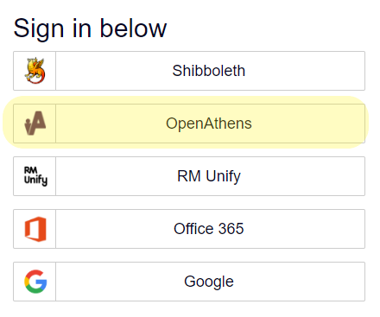
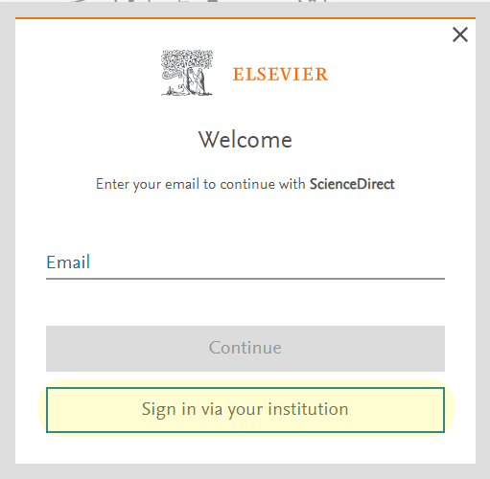
Tips for logging in when you’re off campus
Sometimes when you're off campus you may be asked to pay even though you've already logged on - if this happens do not pay!
You will need to login directly to the database
When you sign into a database look for an :
Institutional login
Open Athens
Notes:
The University of Sunderland uses single sign on to authenticate you to use library e-resources. We’ve tried where possible to make sure when you click on a link form the library web page that you are taken to the correct login page. Due to the differences in privacy settings, browser settings across students own computers you may be asked to login again when you are off campus. If that happens look for either an ‘institutional’ login option or a ‘open athens’ login option.

Slide 8
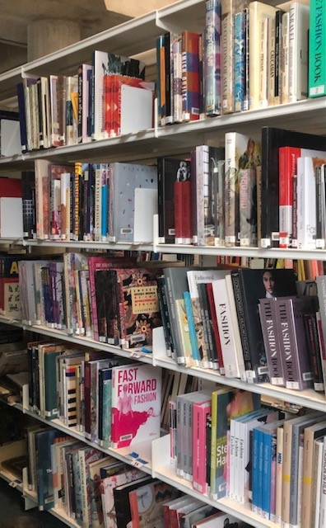
Accessing print only resources
Free Document Delivery
Photocopies or digitised copies of articles or book chapters that we have in our Sunderland Libraries
Digitised copies of articles or book chapters from other libraries through interlibrary loan
You must complete the Online Document Request Form
Notes:
The University of Sunderland uses single sign on to authenticate you to use library e-resources. We’ve tried where possible to make sure when you click on a link form the library web page that you are taken to the correct login page. Due to the differences in privacy settings, browser settings across students own computers you may be asked to login again when you are off campus. If that happens look for either an ‘institutional’ login option or a ‘open athens’ login option.

Slide 9
Cite Them Right (Referencing help)
Log in with your University User ID & password.
Help to reference many different sources
Develop your understanding of plagiarism (and how to avoid it)
Watch the Cite Them Right video (2:27 mins)

Slide 10
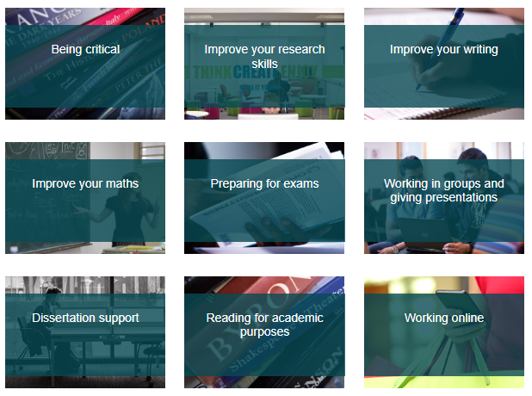
Study Skills Guides & Videos
Videos & guides on a range of topics to help you succeed in your studies
Off Campus Induction https://wp.sunderland.ac.uk/studyskills/library-welcome/
Notes:
There is a lot of support on the University of Sunderland Study Skills pages. There are guides to help you develop your study skills and to help you make the most of library resources you will be able to attend webinars.

Slide 11
Contact the University Library
24/7 chat https://library.Sunderland.ac.uk
Email library@sunderland.ac.uk
Social Media @UniOfSunLib

